Slide 1
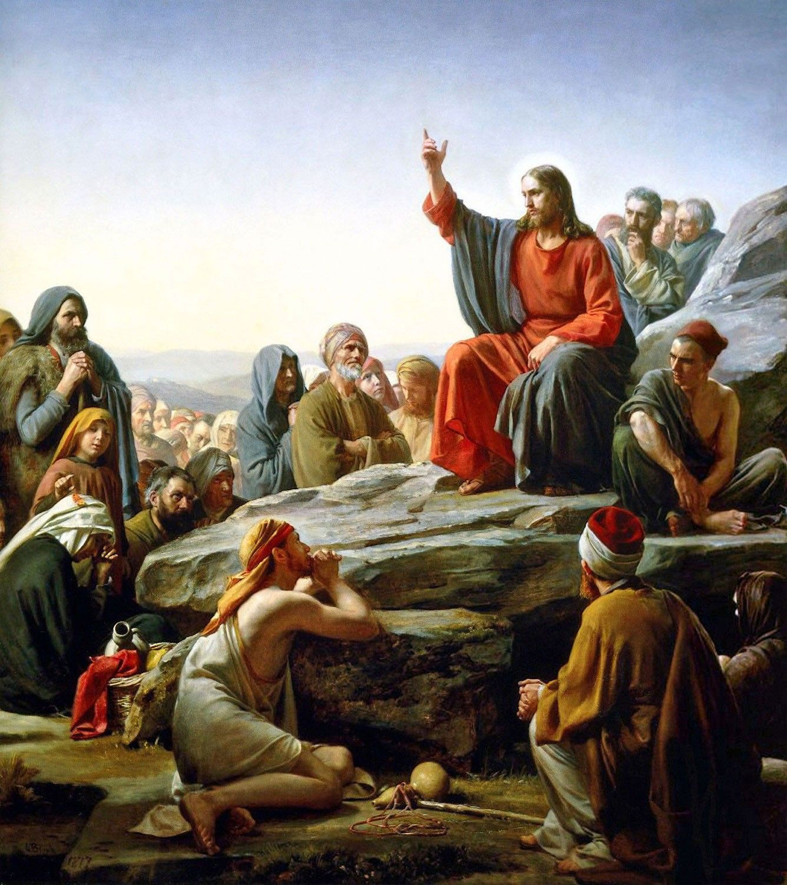
LIFE OF CHRIST
PART 21

Slide 2
Matthew 5:2 Then He opened His mouth and taught them, saying: ³ "Blessed are the poor in spirit, For theirs is the kingdom of heaven. ⁴ Blessed are those who mourn, For they shall be comforted. ⁵ Blessed are the meek, For they shall inherit the earth. ⁶ Blessed are those who hunger and thirst for righteousness, For they shall be filled. ⁷ Blessed are the merciful, For they shall obtain mercy. ⁸ Blessed are the pure in heart, For they shall see God. ⁹ Blessed are the peacemakers, For they shall be called sons of God. ¹⁰ Blessed are those who are persecuted for righteousness' sake, For theirs is the kingdom of heaven. ¹¹ "Blessed are you when they revile and persecute you, and say all kinds of evil against you falsely for My sake. ¹² "Rejoice and be exceedingly glad, for great is your reward in heaven, for so they persecuted the prophets who were before you.

Slide 3
⁶ Blessed are those who hunger and thirst for righteousness, For they shall be filled.

Slide 4
Hunger means: 1) to hunger, be hungry 1a) to suffer want 1b) to be needy 2) metaph. to crave ardently, to seek with eager desire

Slide 5
Thirst means: 1) to suffer thirst, suffer from thirst 1a) figuratively, those who are said to thirst who painfully feel their want of, and eagerly long for, those things by which the soul is refreshed, supported, strengthened

Slide 6
Luke 4:2 being tempted for forty days by the devil. And in those days He ate nothing, and afterward, when they had ended, He was hungry.
John 19:28 After this, Jesus, knowing that all things were now accomplished, that the Scripture might be fulfilled, said, "I thirst!"

Slide 7
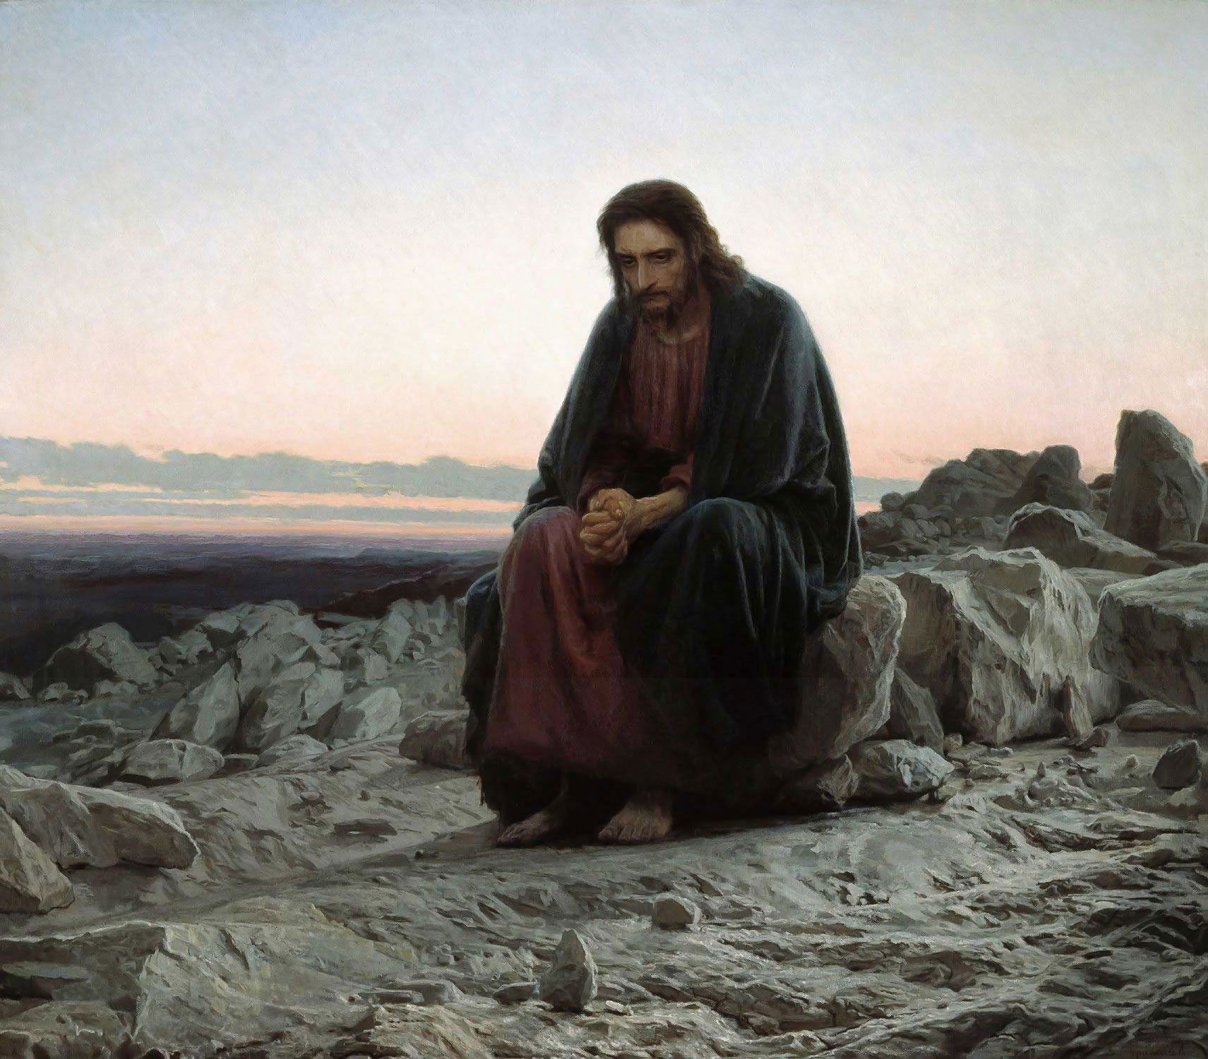

Slide 8
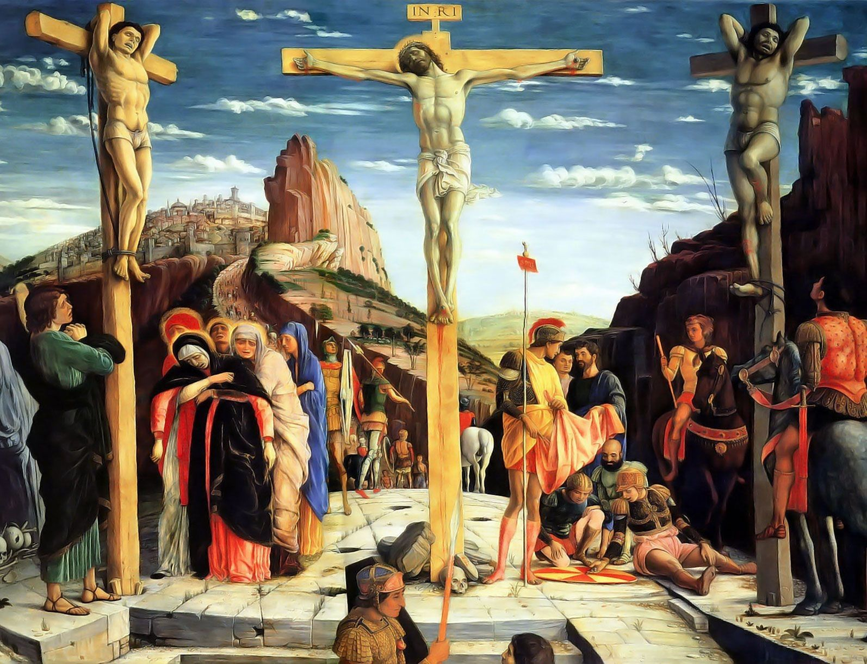

Slide 9
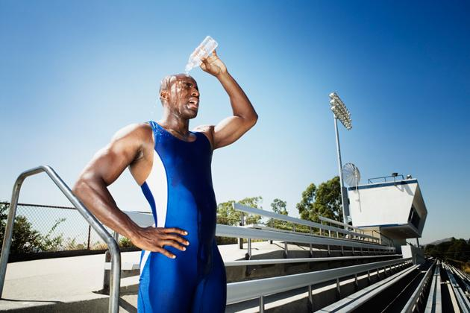

Slide 10
John 6:35 And Jesus said to them, "I am the bread of life. He who comes to Me shall never hunger, and he who believes in Me shall never thirst.
John 4:13 Jesus answered and said to her, "Whoever drinks of this water will thirst again, ¹⁴ "but whoever drinks of the water that I shall give him will never thirst. But the water that I shall give him will become in him a fountain of water springing up into everlasting life."

Slide 11
Job 23:12 I have not departed from the commandment of His lips; I have treasured the words of His mouth More than my necessary food.

Slide 12
Psalm 63:1 …O God, You are my God; Early will I seek You; My soul thirsts for You; My flesh longs for You In a dry and thirsty land Where there is no water.

Slide 13
1) in a broad sense: state of him who is as he ought to be, righteousness, the condition acceptable to God 1a) the doctrine concerning the way in which man may attain a state approved of God 1b) integrity, virtue, purity of life, rightness, correctness of thinking feeling, and acting

Slide 14
Psalm 119:172 My tongue shall speak of Your word, For all Your commandments are righteousness.

Slide 15
Romans 1:16 For I am not ashamed of the gospel of Christ, for it is the power of God to salvation for everyone who believes, for the Jew first and also for the Greek. ¹⁷ For in it the righteousness of God is revealed from faith to faith; as it is written, "The just shall live by faith."

Slide 16
Luke 1:6 And they were both righteous before God, walking in all the commandments and ordinances of the Lord blameless.

Slide 17
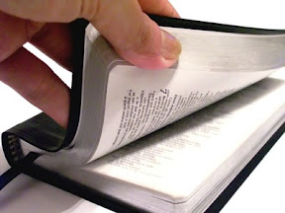

Slide 18
Psalm 107:9 For He satisfies the longing soul, And fills the hungry soul with goodness.

Slide 19
⁷ Blessed are the merciful, For they shall obtain mercy.

Slide 20
FRIBERG- merciful, compassionate, sympathetic … of a person who shows pity to others

Slide 21
THAYER - 1) to have mercy on 2) to help one afflicted or seeking aid 3) to help the afflicted, to bring help to the wretched 4) to experience mercy

Slide 22
Proverbs 11:17 The merciful man does good for his own soul, But he who is cruel troubles his own flesh.

Slide 23
Joshua 2:1 Now Joshua the son of Nun sent out two men from Acacia Grove to spy secretly, saying, "Go, view the land, especially Jericho." So they went, and came to the house of a harlot named Rahab, and lodged there. ² And it was told the king of Jericho, saying, "Behold, men have come here tonight from the children of Israel to search out the country." ³ So the king of Jericho sent to Rahab, saying, "Bring out the men who have come to you, who have entered your house, for they have come to search out all the country."

Slide 24
⁴ Then the woman took the two men and hid them. So she said, "Yes, the men came to me, but I did not know where they were from. ⁵ "And it happened as the gate was being shut, when it was dark, that the men went out. Where the men went I do not know; pursue them quickly, for you may overtake them." ⁶ (But she had brought them up to the roof and hidden them with the stalks of flax, which she had laid in order on the roof.) ⁷ Then the men pursued them by the road to the Jordan, to the fords. And as soon as those who pursued them had gone out, they shut the gate. ⁸ Now before they lay down, she came up to them on the roof,

Slide 25
⁹ and said to the men: "I know that the LORD has given you the land, that the terror of you has fallen on us, and that all the inhabitants of the land are fainthearted because of you. ¹⁰ "For we have heard how the LORD dried up the water of the Red Sea for you when you came out of Egypt, and what you did to the two kings of the Amorites who were on the other side of the Jordan, Sihon and Og, whom you utterly destroyed. ¹¹ "And as soon as we heard these things, our hearts melted; neither did there remain any more courage in anyone because of you, for the LORD your God, He is God in heaven above and on earth beneath.

Slide 26
¹² "Now therefore, I beg you, swear to me by the LORD, since I have shown you kindness, that you also will show kindness to my father's house, and give me a true token, ¹³ "and spare my father, my mother, my brothers, my sisters, and all that they have, and deliver our lives from death." ¹⁴ So the men answered her, "Our lives for yours, if none of you tell this business of ours. And it shall be, when the LORD has given us the land, that we will deal kindly and truly with you."

Slide 27
But he who is cruel troubles his own flesh.

Slide 28
Matthew 18:23 "Therefore the kingdom of heaven is like a certain king who wanted to settle accounts with his servants. ²⁴ "And when he had begun to settle accounts, one was brought to him who owed him ten thousand talents. ²⁵ "But as he was not able to pay, his master commanded that he be sold, with his wife and children and all that he had, and that payment be made. ²⁶ "The servant therefore fell down before him, saying, 'Master, have patience with me, and I will pay you all.' ²⁷ "Then the master of that servant was moved with compassion, released him, and forgave him the debt.

Slide 29
²⁸ "But that servant went out and found one of his fellow servants who owed him a hundred denarii; and he laid hands on him and took him by the throat, saying, 'Pay me what you owe!' ²⁹ "So his fellow servant fell down at his feet and begged him, saying, 'Have patience with me, and I will pay you all.' ³⁰ "And he would not, but went and threw him into prison till he should pay the debt. ³¹ "So when his fellow servants saw what had been done, they were very grieved, and came and told their master all that had been done. ³² "Then his master, after he had called him, said to him, 'You wicked servant! I forgave you all that debt because you begged me.

Slide 30
³³ 'Should you not also have had compassion on your fellow servant, just as I had pity on you?' ³⁴ "And his master was angry, and delivered him to the torturers until he should pay all that was due to him. ³⁵ "So My heavenly Father also will do to you if each of you, from his heart, does not forgive his brother his trespasses."

Slide 31
James 2:13 For judgment is without mercy to the one who has shown no mercy. Mercy triumphs over judgment.

Slide 32
1 Timothy 1:12 And I thank Christ Jesus our Lord who has enabled me, because He counted me faithful, putting me into the ministry, ¹³ although I was formerly a blasphemer, a persecutor, and an insolent man; but I obtained mercy because I did it ignorantly in unbelief. ¹⁴ And the grace of our Lord was exceedingly abundant, with faith and love which are in Christ Jesus. ¹⁵ This is a faithful saying and worthy of all acceptance, that Christ Jesus came into the world to save sinners, of whom I am chief. ¹⁶ However, for this reason I obtained mercy, that in me first Jesus Christ might show all longsuffering, as a pattern to those who are going to believe on Him for everlasting life.

Slide 33
Colossians 3:12 Therefore, as the elect of God, holy and beloved, put on tender mercies, kindness, humility, meekness, longsuffering; ¹³ bearing with one another, and forgiving one another, if anyone has a complaint against another; even as Christ forgave you, so you also must do.

Slide 34
⁸ Blessed are the pure in heart, For they shall see God.

Slide 35
Matthew 18:1 At that time the disciples came to Jesus, saying, "Who then is greatest in the kingdom of heaven?" ² Then Jesus called a little child to Him, set him in the midst of them, ³ and said, "Assuredly, I say to you, unless you are converted and become as little children, you will by no means enter the kingdom of heaven. ⁴ "Therefore whoever humbles himself as this little child is the greatest in the kingdom of heaven.

Slide 36
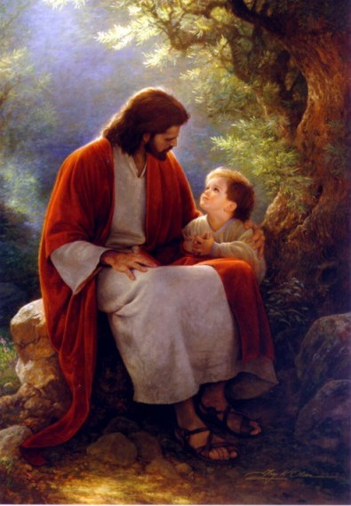

Slide 37
Romans 12:1 I beseech you therefore, brethren, by the mercies of God, that you present your bodies a living sacrifice, holy, acceptable to God, which is your reasonable service. ² And do not be conformed to this world, but be transformed by the renewing of your mind, that you may prove what is that good and acceptable and perfect will of God.

Slide 38
Psalm 51:10 Create in me a clean heart, O God, And renew a steadfast spirit within me.

Slide 39
James 4:8 Draw near to God and He will draw near to you. Cleanse your hands, you sinners; and purify your hearts, you double-minded. ⁹ Lament and mourn and weep! Let your laughter be turned to mourning and your joy to gloom. ¹⁰ Humble yourselves in the sight of the Lord, and He will lift you up.

Slide 40
1 Peter 1:22 Since you have purified your souls in obeying the truth through the Spirit in sincere love of the brethren, love one another fervently with a pure heart, ²³ having been born again, not of corruptible seed but incorruptible, through the word of God which lives and abides forever,

Slide 41
Acts 15:7 And when there had been much dispute, Peter rose up and said to them: "Men and brethren, you know that a good while ago God chose among us, that by my mouth the Gentiles should hear the word of the gospel and believe. ⁸ "So God, who knows the heart, acknowledged them by giving them the Holy Spirit, just as He did to us, ⁹ "and made no distinction between us and them, purifying their hearts by faith.

Slide 42
Matthew 23:25 "Woe to you, scribes and Pharisees, hypocrites! For you cleanse the outside of the cup and dish, but inside they are full of extortion and self-indulgence. ²⁶ "Blind Pharisee, first cleanse the inside of the cup and dish, that the outside of them may be clean also. ²⁷ "Woe to you, scribes and Pharisees, hypocrites! For you are like whitewashed tombs which indeed appear beautiful outwardly, but inside are full of dead men's bones and all uncleanness. ²⁸ "Even so you also outwardly appear righteous to men, but inside you are full of hypocrisy and lawlessness.

Slide 43
Proverbs 23:7 For as he thinks in his heart, so is he.

Slide 44
1 John 3:2 Beloved, now we are children of God; and it has not yet been revealed what we shall be, but we know that when He is revealed, we shall be like Him, for we shall see Him as He is. ³ And everyone who has this hope in Him purifies himself, just as He is pure.

